Slide 1
Taking Your Map Books to the Next Level
Using ArcPy to create dynamic content in your maps
Melissa Albino Hegeman
October 19, 2016
NEARC Fall Meeting
Notes:
I work in the Marine Data and GIS unit of the Division of Marine Resources. And I am the only one in the unit. So I have gone all in on the automation thing.

Slide 2
What are Map Books?
A collection of maps and their supporting information
Notes:
Mapbooks are a collection of maps and their supporting information. They are obviously a very powerful and useful tool. The fact that we’ve can talk about them for an hour and a half should testify to that.

Slide 3
How Does DMR Use Map Books?
Before and after
Tidal wetlands comparisons
Regulatory packages
Notes:
I’ve noticed that temporal comparisons are the most common use for me at this point. Everyone wants to know how many acres X years ago vs how many acres today, or some version of that. Or how will this proposed regulatory change affect the acres available for shellfishing or something along those lines.

Slide 4
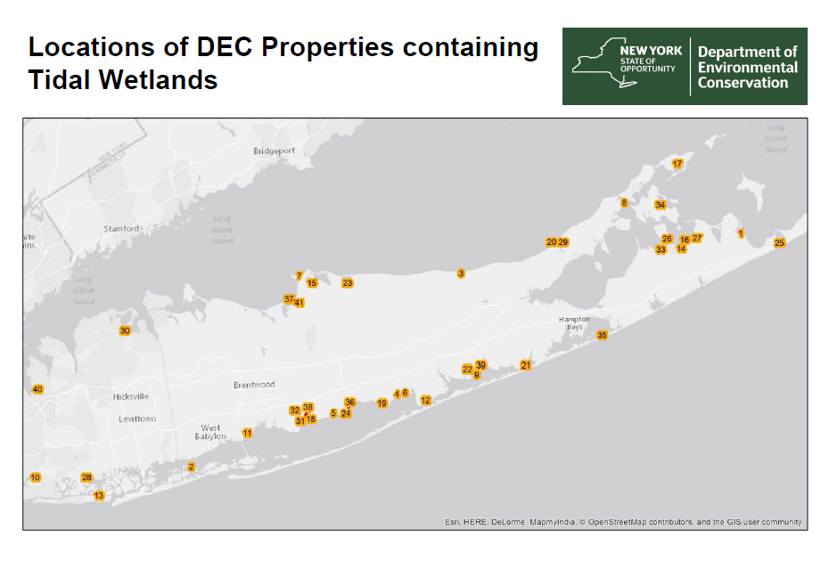
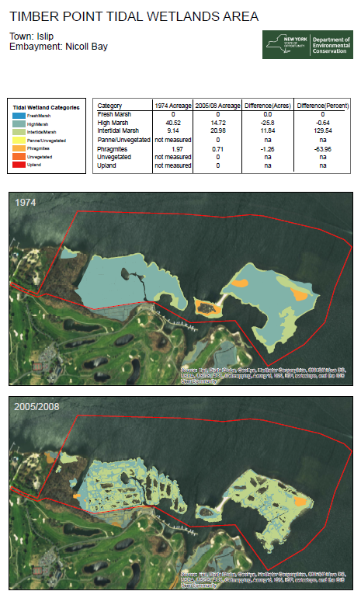
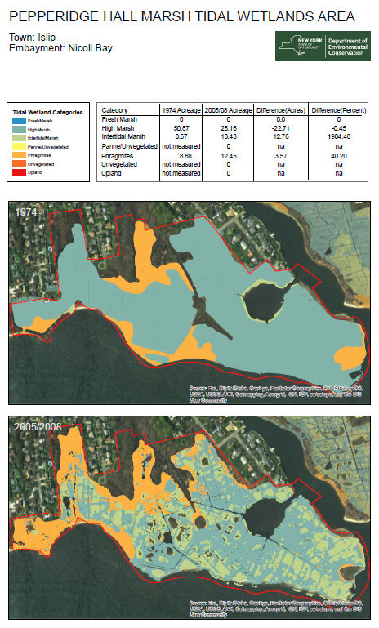
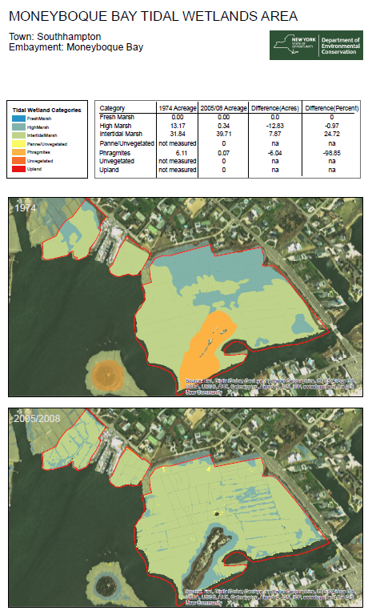
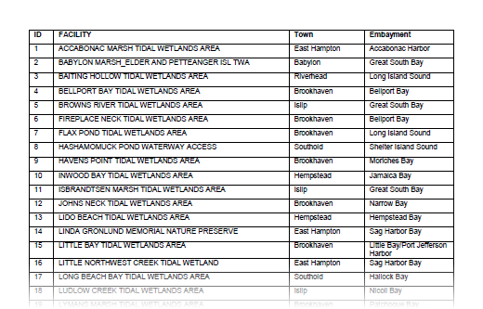
Notes:
This is the project that kinda kick started my effort to automate this. I received a request to compare two tidal wetland data sets - 1974 and circa 2005/2008 - within DEC owned properties. So it turns out that there are >40 DEC properties that are designated as tidal wetlands. And I need something by tomorrow – or something ridiculous like that.
These maps were designed to help managers select potential restoration sites. It has two data frames with the same extent but covering different time periods. So you can see how the wetlands changed. And then it has the basic information in a table at the top. And I wanted a table that summarized acreage, I couldn’t figure out a way to make the numbers in the table update based on the extent and the features visible.
Side note: you can do something similar with the production mapping extension, but $. So I had to figure a way around that.

Slide 5
Esri’s Mapbook Workflow
And where we will customize it.
Notes:
Let’s talk about Esri’s workflow for a minute, and where I am going to change it to suit my particular projects.

Slide 6
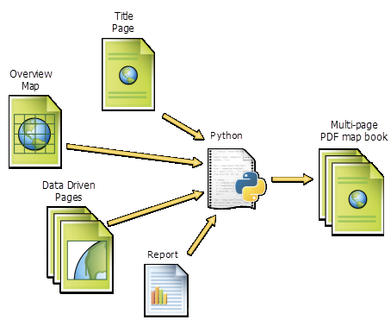
ESRI’s Mapbook Workflow
Data driven pages with ArcPy.mapping scripts for custom books with dynamic content
Notes:
Here is a graphic from the ArcGIS help documents that show all of the components to this process.

Slide 7

ESRI’s Mapbook
Notes:
And the dynamic content is where this falls short for me. Data driven pages does not provide a dynamic analysis with updated tables based on that analysis that I was looking for.

Slide 8
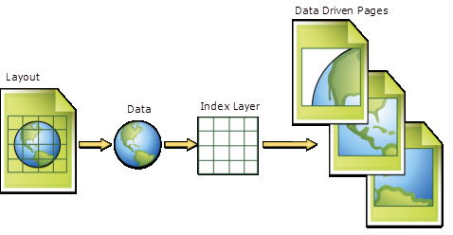
ESRI’s Data Driven Pages
Notes:
So, let’s look a little closer at data driven pages. This is Esri’s help documentation for the general work flow of the Data Driven Pages tool. There are three inputs that are fed into the ddp tool: our map layout, the data we want analyzed and our index layer.

Slide 9
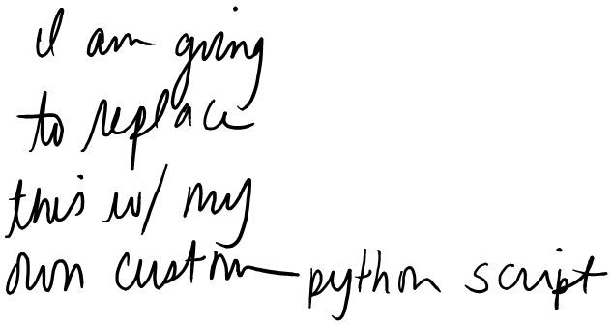

ESRI’s Data Driven Pages
Notes:
This method follows esri’s workflow, except instead of using the ddp tool, we are going to write our own. But the preparation remains the same.

Slide 10
The Set Up
Creating your layout templates
Notes:
How do we prepare our “stuff” for ArcPy. Let’s start out with the layout template.

Slide 11
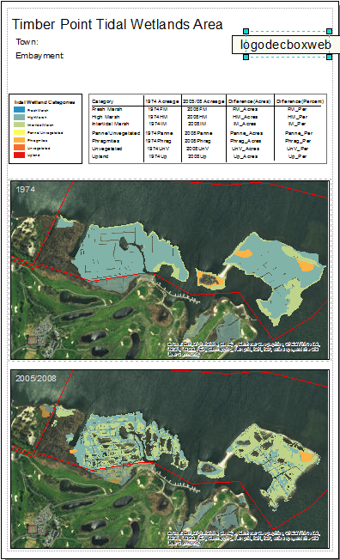
The Layout Template
This is what all your maps will be based on, so it is important that you like it.
Name all of your layout elements!
No detail is too small.
Notes:
This is going to be what your maps look like. Everything you see on the map is considered a layout element. Name it ALL! No detail is too small.

Slide 12
Name your
text boxes.
These will be
populated form
The data’s
attributes
name
town
embayment
Legend
1974
Name your
data frames
2008
Notes:
Let’s look a little closer. If you want to programmatically update anything, it must be named. I want the header info updated and the extents of each data frame to match. So I need to make sure I name them.

Slide 13
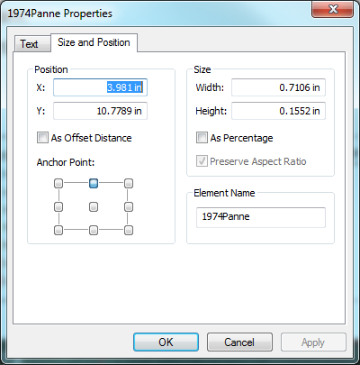
Notes:
Just a reminder, you can set the name of the element in the properties box. FYI don’t start a name with a number. Python doesn’t like it.

Slide 14

Name your
text boxes.
These will be
populated form
The data’s
attributes
name
town
embayment
Legend
1974
Name your
data frames
2008
Notes:
Just a note. I named things pretty specifically the first time around. I want to turn this into a script I can use repeatedly for all my before and after maps no matter what the template looks like.

Slide 15
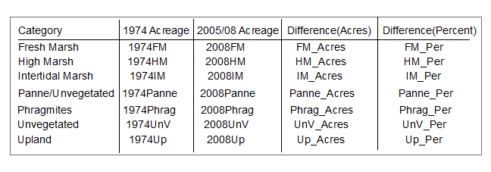
town
Legend
horzLine
2008
Name your
data frames
box
vertLine
This table is actually composed of individual text boxes and graphics.
Each must be named individually.
Notes:
The table is the most complicated part of all of this. It is a combination of graphic and text elements. There are 40 individual text boxes here that we will reference later.
We will use ArcPy to manipulate all of these components to update the contents, center the text, etc.

Slide 16
Some Important Notes
You want to make your script as reusable as possible
Create some naming conventions for your layout elements
For example, the map title = title, != Title or MapTitle, etc.
Notes:
I want to make this a universal tool for comparing two time periods- it will take any layout template you have (provided you follow the naming rules) and spit out your mapbook. Deciding on some rules for naming your elements will help in minimizing the amount of re-writing you have to do for your next mapbook. For example, always name the title, title. Not Title or MapName or whatever. ***And tell everyone else that might ask you for your help to follow these conventions, too.

Slide 17
The Mechanics
Creating your ArcPy script
Notes:
Before diving head first into the code, I find it helpful to actually write down what I want it to do and what information I have to collect before I can start. I am going to continue to use the tidal wetland example, but hopefully this is something you can adjust to your own projects.

Slide 18
What is it going to do?
For each property:
Calculate the tidal wetland acreage, by type, for each time period
Calculate the change in acreage and % difference between the two time periods
Update the table with that information
Use the map template to create a map based on the visible extent of each DEC tidal wetland property
Notes:
You are going to end up with individual mxd files for each area, so you will be able to go in and edit them individually later.

Slide 19
What data do we need?
A polygon feature class containing each property to be analyzed (index layer)
A 1974 tidal wetland feature class
A 2005/2008 tidal wetland feature class

Slide 20
Define the layout map and define the data frames
Define all the layout elements of the map document
Set the default values
Use search cursor to cycle through features in index layer
Get values from the feature attribute to update text
Pan to extent and match the extent of the two data frames
Summarize tidal wetland acreage and update table
Save a copy of the new map
Back to step 4
Notes:
Rather than go through the code line by line, I just want to highlight the overall process and point out some sticking points that I came across and what I learned from that. You can find the complete code on GitHub, search mapbook_nearc. I have the link on the last slide.

Slide 21
Define the layout map and define the data frames
Define all the layout elements of the map document
Set the default values
Use search cursor to cycle through features in index layer
Get values from the feature attribute to update text
Pan to extent and match the extent of the two data frames
Summarize tidal wetland acreage and update table
Save a copy of the new map
Back to step 4
Notes:
We need to define all the elements of the layout template

Slide 22
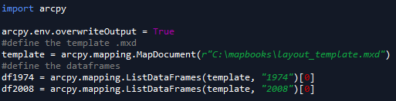
Define the map layout and each data frame.
Notes:
Let’s get in the weeds a bit…
You start to reference all the elements you named earlier right away.

Slide 23

Define the map layout and each data frame.
Notes:
So you can begin to see why doing all that ground work was important. If I stick to a before and after naming convention, I don’t have to worry about going in and changing all of this.

Slide 24
Define the layout map and define the data frames
Define all the layout elements of the map document
Set the default values
Use search cursor to cycle through features in index layer
Get values from the feature attribute to update text
Pan to extent and match the extent of the two data frames
Summarize tidal wetland acreage and update table
Save a copy of the new map
Back to step 4

Slide 25
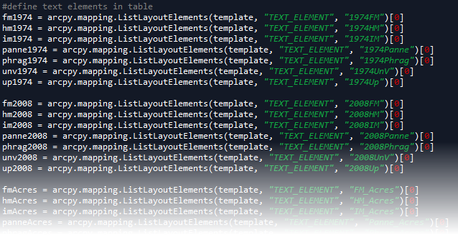
Notes:
I am a advanced beginner coder, at best. With no computer science background. I learned some really useful python methods in the course of developing this project. In the hopes that I will save a least a few people some time, I want to share some of the short cuts I learned.
I started out defining each text element individually. Which took dozens of lines of code and was incredibly unwieldly. So, if you ever notice a block of code that looks like this, consider using a python dictionary instead.

Slide 26
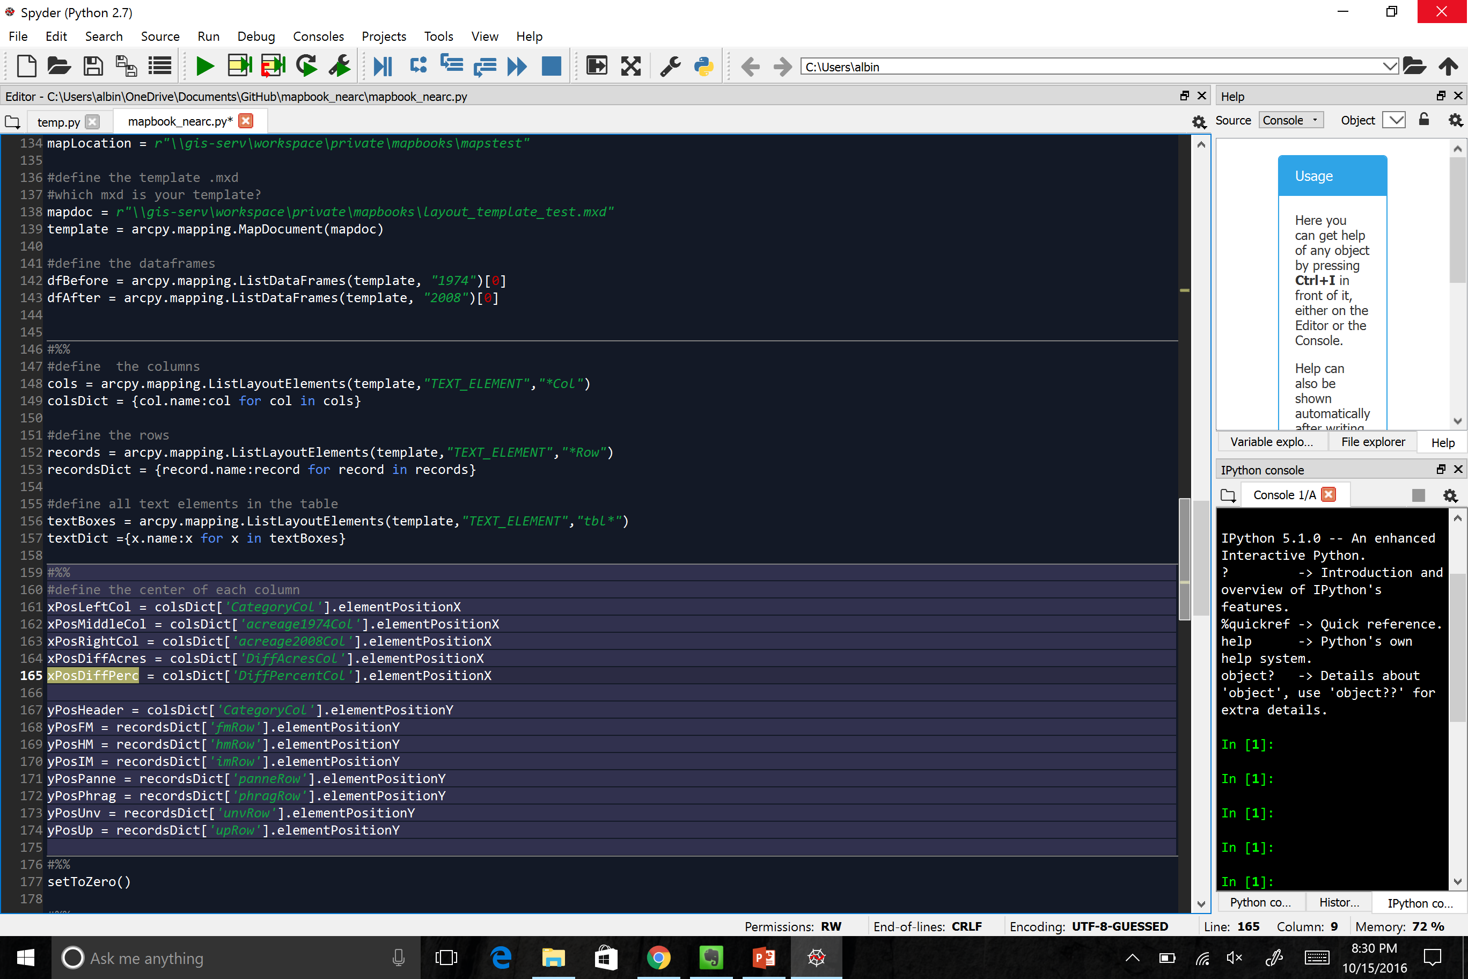
List = [1,2,3,4]
{key:value for key in List}
{x:2x for x in List}
{1:2, 2:4, 3:6, 4:8}
Notes:
This does pretty much the same thing, in a lot less lines using the dictionary comprehension function.

Slide 27
Create the list using the ArcPy
Use dictionary comprehension to dynamically create the dictionary.
Refer to each text box individually by referencing the key – colsDict[‘columnName’]
Notes:
In the dictionary that we are creating the key is the name of the element (which we defined ourselves in the layout document). The value is the entire text element.
Once again, how we name these elements is important. I am able to isolate just the table elements and then divide them into different groups based on what I need them for.

Slide 28
Import necessary modules
Define the layout map and define the data frames
Define all the layout elements of the map document
Set the default values for the table
Use search cursor to cycle through features in index layer
Get values from the feature attribute to update text
Pan to extent and match the extent of the two data frames
Summarize tidal wetland acreage and update table
Save a copy of the new map
Back to step 5
Notes:
Now we are done defining all the elements.

Slide 29
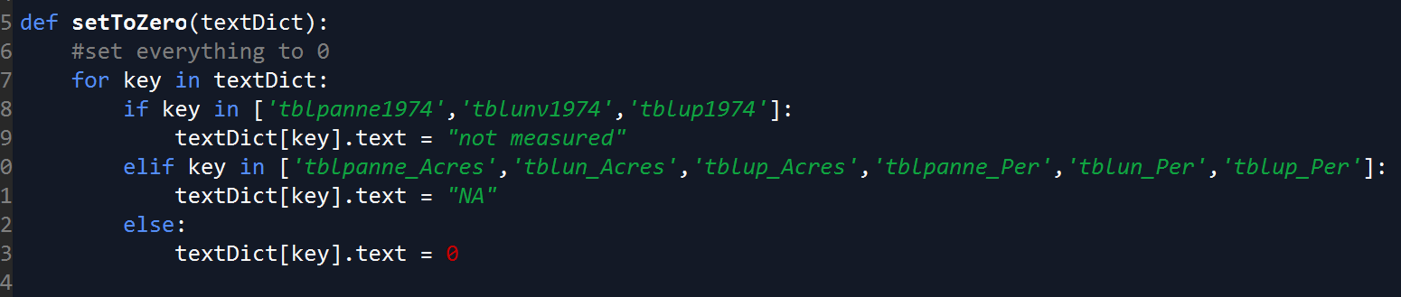

Slide 30


Notes:
This function takes one argument – the dictionary that is holding all of the table “cells”. I am just setting the default value to zero with the exception of these special cases that I know about.

Slide 31
Import necessary modules
Define the layout map and define the data frames
Define all the layout elements of the map document
Set the default values for the table
Use search cursor to cycle through features in index layer
Get values from the feature attribute to update text
Pan to extent and match the extent of the two data frames
Summarize tidal wetland acreage and update table
Save a copy of the new map
Back to step 5
Notes:
I am just using a search cursor to cycle through all of the properties. This is pretty standard.

Slide 32
Import necessary modules
Define the layout map and define the data frames
Define all the layout elements of the map document
Set the default values for the table
Use search cursor to cycle through features in index layer
Get values from the feature attribute to update text
Pan to extent and match the extent of the two data frames
Summarize tidal wetland acreage and update table
Save a copy of the new map
Back to step 5
Notes:
First things first, let’s update the map header with information from that property.

Slide 33
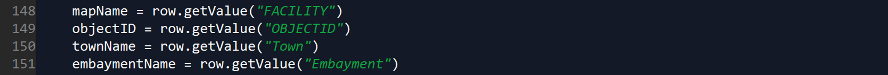
We get the header values from the DEC lands attribute table.
Notes:
For row in rows…

Slide 34
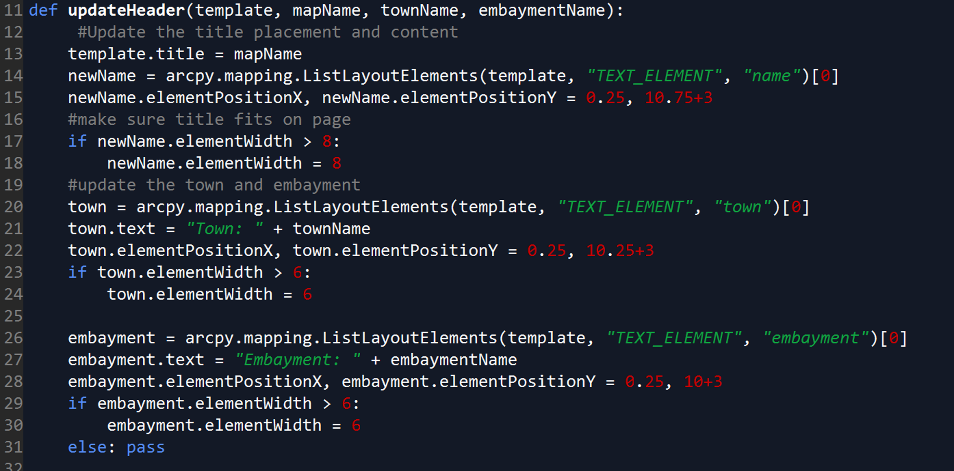
Notes:
We are just going to drop that information we just found into this function to update the text at the top of the map.

Slide 35
Import necessary modules
Define the layout map and define the data frames
Define all the layout elements of the map document
Set the default values for the table
Use search cursor to cycle through features in index layer
Get values from the feature attribute to update text
Pan to extent and match the extent of the two data frames
Summarize tidal wetland acreage and update table
Save a copy of the new map
Back to step 5

Slide 36
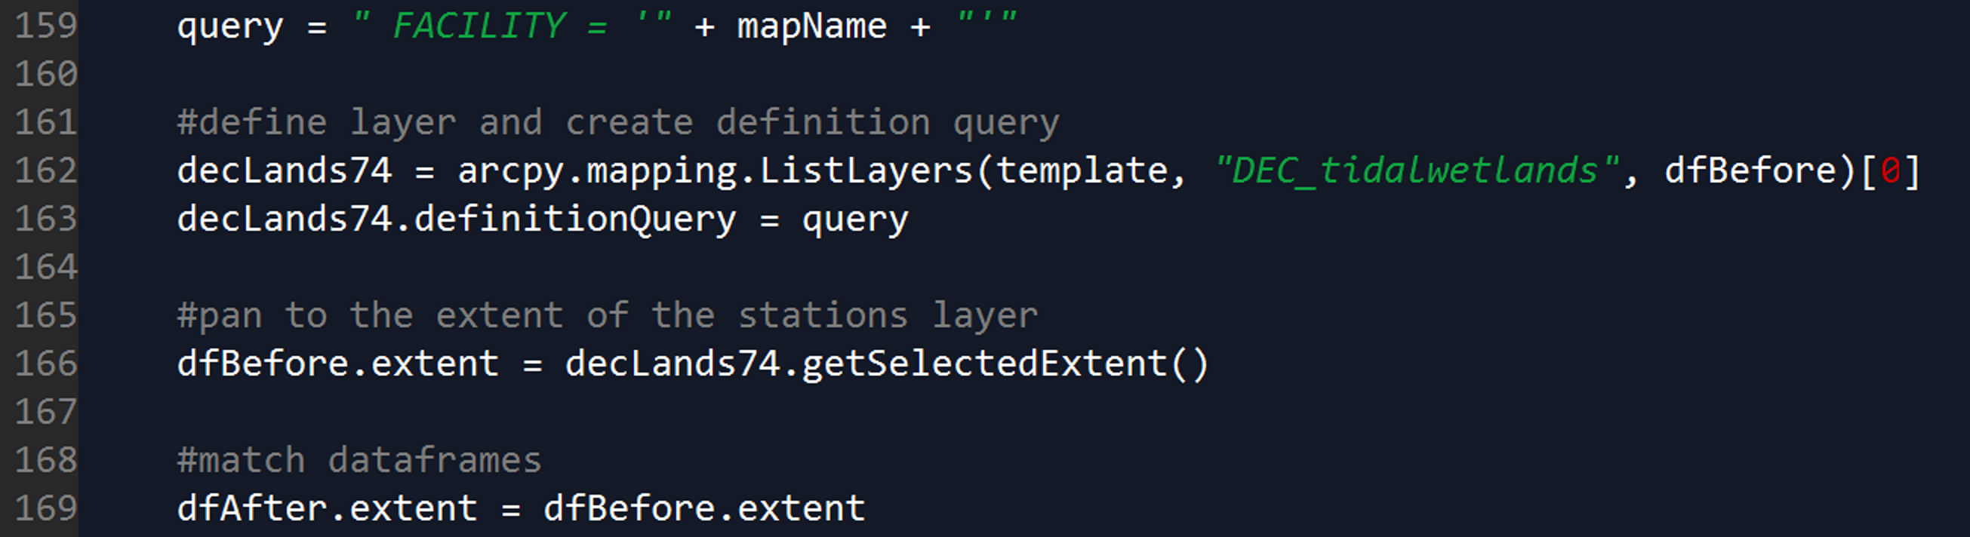
Notes:
I am using that same info from the attribute table to create a definition query. This way I am only looking at the property of interest. I set the data frame extent to that of the single property. Finally I set the extents of the two data frames to be equal.

Slide 37
Import necessary modules
Define the layout map and define the data frames
Define all the layout elements of the map document
Set the default values for the table
Use search cursor to cycle through features in index layer
Get values from the feature attribute to update text
Pan to extent and match the extent of the two data frames
Summarize tidal wetland acreage and update table
Save a copy of the new map
Back to step 5
Notes:
Before I start doing anything crazy, I just want to set some default values.

Slide 38
Notes:
We are going to summarize the 1974 acreage by tw category, then add that table to them map, temporarily

Slide 39
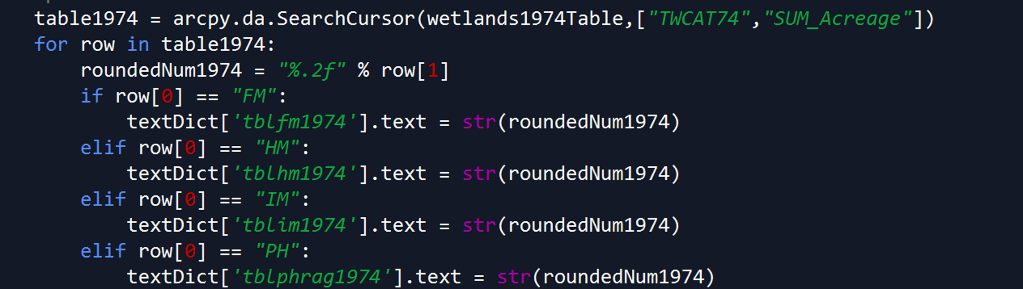
Notes:
The table only has 2 fields: Category and acreage. We’re going to go through each row of the table, round off the number to 2 decimal places, then update the table based.

Slide 40
Import necessary modules
Define the layout map and define the data frames
Define all the layout elements of the map document
Set the default values for the table
Use search cursor to cycle through features in index layer
Get values from the feature attribute to update text
Pan to extent and match the extent of the two data frames
Summarize tidal wetland acreage and update table
Save a copy of the new map
Back to step 5
Notes:
Save a copy of the new map document and then start all over again at step 5.

Slide 41
Thank You
Connect with us: Facebook: www.facebook.com/NYSDEC Twitter: twitter.com/NYSDEC Flickr: www.flickr.com/photos/nysdec
Melissa Albino Hegeman
GIS and Data Coordinator
melissa.albino@dec.ny.gov
631-444-0464
github.com/mhegeman/mapbook_nearc

